Slide 1

Azure Fundamentals
UNIT-1
Cloud Concepts

Slide 2
Introduction to Microsoft Azure Fundamentals
Microsoft Azure is a cloud computing platform with an ever-expanding set of services to help you build solutions to meet your business goals. Azure services support everything from simple to complex. Azure has simple web services for hosting your business presence in the cloud. Azure also supports running fully virtualized computers managing your custom software solutions. Azure provides a wealth of cloud-based services like remote storage, database hosting, and centralized account management. Azure also offers new capabilities like artificial intelligence (AI) and Internet of Things (IoT) focused services.

Slide 3
What is Azure Fundamentals?
Azure Fundamentals is a series of three learning paths that familiarize you with Azure and its many services and features.
Whether you're interested in compute, networking, or storage services; learning about cloud security best practices; or exploring governance and management options, think of Azure Fundamentals as your curated guide to Azure.
Azure Fundamentals includes interactive exercises that give you hands-on experience with Azure. Many exercises provide a temporary Azure portal environment called the sandbox, which allows you to practice creating cloud resources for free at your own pace.
Technical IT experience isn't required; however, having general IT knowledge will help you get the most from your learning experience.

Slide 4
What is cloud computing
Cloud computing is the delivery of computing services over the internet. Computing services include common IT infrastructure such as virtual machines, storage, databases, and networking. Cloud services also expand the traditional IT offerings to include things like Internet of Things (IoT), machine learning (ML), and artificial intelligence (AI).
Because cloud computing uses the internet to deliver these services, it doesn’t have to be constrained by physical infrastructure the same way that a traditional datacenter is. That means if you need to increase your IT infrastructure rapidly, you don’t have to wait to build a new datacenter—you can use the cloud to rapidly expand your IT footprint.

Slide 5
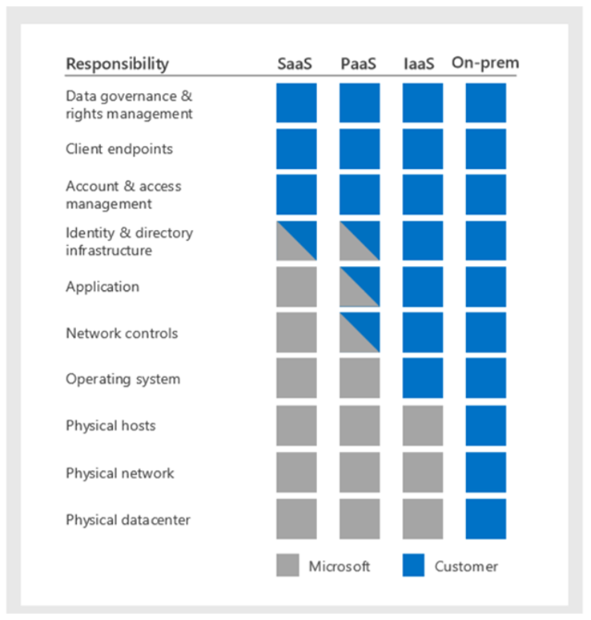
The shared responsibility model
You’ll always be responsible for:
The information and data stored in the cloud
Devices that are allowed to connect to your cloud (cell phones, computers, and so on)
The accounts and identities of the people, services, and devices within your organization
The cloud provider is always responsible for:
The physical datacenter
The physical network
The physical hosts
Your service model will determine responsibility for things like:
Operating systems
Network controls
Applications
Identity and infrastructure

Slide 6
HISTORY OF CLOUD COMPUTING
Before emerging the cloud computing, there was Client/Server computing which is basically a centralized storage in which all the software applications, all the data and all the controls are resided on the server side.
If a single user wants to access specific data or run a program, he/she need to connect to the server and then gain appropriate access, and then he/she can do his/her business.
Then after, distributed computing came into picture, where all the computers are networked together and share their resources when needed.
On the basis of above computing, there was emerged of cloud computing concepts that later implemented.
At around in 1961, John MacCharty suggested in a speech at MIT that computing can be sold like a utility, just like a water or electricity. It was a brilliant idea, but like all brilliant ideas, it was ahead if its time, as for the next few decades, despite interest in the model, the technology simply was not ready for it.

Slide 7
HISTORY OF CLOUD COMPUTING
But of course time has passed and the technology caught that idea and after few years we mentioned that:
In 1999, Salesforce.com started delivering of applications to users using a simple website. The applications were delivered to enterprises over the Internet, and this way the dream of computing sold as utility were true.
In 2002, Amazon started Amazon Web Services, providing services like storage, computation and even human intelligence. However, only starting with the launch of the Elastic Compute Cloud in 2006 a truly commercial service open to everybody existed.
In 2009, Google Apps also started to provide cloud computing enterprise applications.
Of course, all the big players are present in the cloud computing evolution, some were earlier, some were later. In 2009, Microsoft launched Windows Azure, and companies like Oracle and HP have all joined the game. This proves that today, cloud computing has become mainstream.

Slide 8
CLOUD COMPUTING ARCHITECTURE
As we know, cloud computing technology is used by both small and large organizations to store the information in cloud and access it from anywhere at anytime using the internet connection.
Cloud computing architecture is a combination of service-oriented architecture and event-driven architecture.
Cloud computing architecture is divided into the following two parts -
Front End
Back End

Slide 9
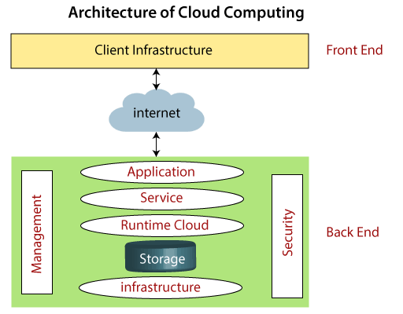
CLOUD COMPUTING ARCHITECTURE

Slide 10
CLOUD COMPUTING ARCHITECTURE
FRONT END
The front end is used by the client. It contains client-side interfaces and applications that are required to access the cloud computing platforms. The front end includes web servers (including Chrome, Firefox, internet explorer, etc.), thin & fat clients, tablets, and mobile devices.
BACK END
The back end is used by the service provider. It manages all the resources that are required to provide cloud computing services. It includes a huge amount of data storage, security mechanism, virtual machines, deploying models, servers, traffic control mechanisms, etc.

Slide 11
CLOUD COMPUTING ARCHITECTURE
There are the following components of cloud computing architecture –
1. Client Infrastructure
Client Infrastructure is a Front end component. It provides GUI (Graphical User Interface) to interact with the cloud.
2. Application
The application may be any software or platform that a client wants to access.
3. Service
A Cloud Services manages that which type of service you access according to the client’s requirement.

Slide 12
CLOUD COMPUTING ARCHITECTURE
Cloud computing offers the following three type of services:
i. Software as a Service (SaaS) – It is also known as cloud application services. Mostly, SaaS applications run directly through the web browser means we do not require to download and install these applications. Some important example of SaaS is given below –
Example: Google Apps, Salesforce Dropbox, Slack, Hubspot, Cisco WebEx.
ii. Platform as a Service (PaaS) – It is also known as cloud platform services. It is quite similar to SaaS, but the difference is that PaaS provides a platform for software creation, but using SaaS, we can access software over the internet without the need of any platform.
Example: Windows Azure, Force.com, Magento Commerce Cloud, OpenShift.
iii. Infrastructure as a Service (IaaS) – It is also known as cloud infrastructure services. It is responsible for managing applications data, middleware, and runtime environments.
Example: Amazon Web Services (AWS) EC2, Google Compute Engine (GCE), Cisco Metapod.

Slide 13
CLOUD COMPUTING ARCHITECTURE
4. Runtime Cloud
Runtime Cloud provides the execution and runtime environment to the virtual machines.
5. Storage
Storage is one of the most important components of cloud computing. It provides a huge amount of storage capacity in the cloud to store and manage data.
6. Infrastructure
It provides services on the host level, application level, and network level. Cloud infrastructure includes hardware and software components such as servers, storage, network devices, virtualization software, and other storage resources that are needed to support the cloud computing model.
7. Management
Management is used to manage components such as application, service, runtime cloud, storage, infrastructure, and other security issues in the backend and establish coordination between them.

Slide 14
CLOUD COMPUTING ARCHITECTURE
8. Security
Security is an in-built back end component of cloud computing. It implements a security mechanism in the back end.
9. Internet
The Internet is medium through which front end and back end can interact and communicate with each other.

Slide 15
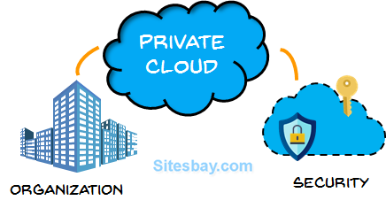
Define cloud models
What are cloud models?
The cloud models define the deployment type of cloud resources. The three main cloud models are: private, public, and hybrid.
Private cloud
A private cloud is, in some ways, the natural evolution from a corporate datacenter. It’s a cloud (delivering IT services over the internet) that’s used by a single entity. Private cloud provides much greater control for the company and its IT department. However, it also comes with greater cost and fewer of the benefits of a public cloud deployment. Finally, a private cloud may be hosted from your on site datacenter. It may also be hosted in a dedicated datacenter offsite, potentially even by a third party that has dedicated that datacenter to your company.

Slide 16
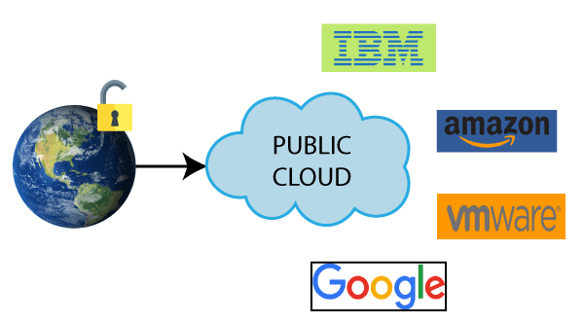
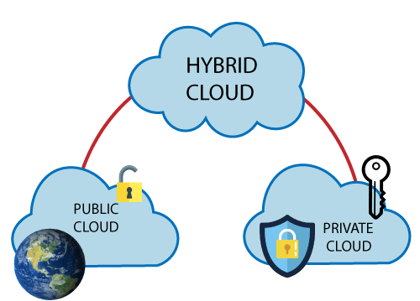
Cloud models
Public cloud
A public cloud is built, controlled, and maintained by a third-party cloud provider. With a public cloud, anyone that wants to purchase cloud services can access and use resources. The general public availability is a key difference between public and private clouds.
Hybrid cloud
A hybrid cloud is a computing environment that uses both public and private clouds in an inter-connected environment. A hybrid cloud environment can be used to allow a private cloud to surge for increased, temporary demand by deploying public cloud resources. Hybrid cloud can be used to provide an extra layer of security. For example, users can flexibly choose which services to keep in public cloud and which to deploy to their private cloud infrastructure.

Slide 17
The following table highlights a few key comparative aspects between the cloud models.
Public cloud | Private cloud | Hybrid cloud
No capital expenditures to scale up | Organizations have complete control over resources and security | Provides the most flexibility
Applications can be quickly provisioned and deprovisioned | Data is not collocated with other organizations’ data | Organizations determine where to run their applications
Organizations pay only for what they use | Hardware must be purchased for startup and maintenance | Organizations control security, compliance, or legal requirements
Organizations don’t have complete control over resources and security | Organizations are responsible for hardware maintenance and updates

Slide 18
Cloud models
Multi-cloud
A fourth, and increasingly likely scenario is a multi-cloud scenario. In a multi-cloud scenario, you use multiple public cloud providers. Maybe you use different features from different cloud providers. Or maybe you started your cloud journey with one provider and are in the process of migrating to a different provider. Regardless, in a multi-cloud environment you deal with two (or more) public cloud providers and manage resources and security in both environments.
Azure Arc
Azure Arc is a set of technologies that helps manage your cloud environment. Azure Arc can help manage your cloud environment, whether it's a public cloud solely on Azure, a private cloud in your datacenter, a hybrid configuration, or even a multi-cloud environment running on multiple cloud providers at once.
Azure VMware Solution
What if you’re already established with VMware in a private cloud environment but want to migrate to a public or hybrid cloud? Azure VMware Solution lets you run your VMware workloads in Azure with seamless integration and scalability.

Slide 19
Describe the consumption-based model
When comparing IT infrastructure models, there are two types of expenses to consider. Capital expenditure (CapEx) and operational expenditure (OpEx).
CapEx is typically a one-time, up-front expenditure to purchase or secure tangible resources. A new building, repaving the parking lot, building a datacenter, or buying a company vehicle are examples of CapEx.
In contrast, OpEx is spending money on services or products over time. Renting a convention center, leasing a company vehicle, or signing up for cloud services are all examples of OpEx.
Cloud computing falls under OpEx because cloud computing operates on a consumption-based model. With cloud computing, you don’t pay for the physical infrastructure, the electricity, the security, or anything else associated with maintaining a datacenter. Instead, you pay for the IT resources you use. If you don’t use any IT resources this month, you don’t pay for any IT resources.

Slide 20
Describe the consumption-based model
This consumption-based model has many benefits, including:
No upfront costs.
No need to purchase and manage costly infrastructure that users might not use to its fullest potential.
The ability to pay for more resources when they're needed.
The ability to stop paying for resources that are no longer needed.
With a traditional datacenter, you try to estimate the future resource needs. If you overestimate, you spend more on your datacenter than you need to and potentially waste money. If you underestimate, your datacenter will quickly reach capacity and your applications and services may suffer from decreased performance. Fixing an under-provisioned datacenter can take a long time. You may need to order, receive, and install more hardware. You'll also need to add power, cooling, and networking for the extra hardware.
In a cloud-based model, you don’t have to worry about getting the resource needs just right. If you find that you need more virtual machines, you add more. If the demand drops and you don’t need as many virtual machines, you remove machines as needed. Either way, you’re only paying for the virtual machines that you use, not the “extra capacity” that the cloud provider has on hand.

Slide 21
Compare cloud pricing models
Cloud computing is the delivery of computing services over the internet by using a pay-as-you-go pricing model. You typically pay only for the cloud services you use, which helps you:
Plan and manage your operating costs.
Run your infrastructure more efficiently.
Scale as your business needs change.
To put it another way, cloud computing is a way to rent compute power and storage from someone else’s datacenter. You can treat cloud resources like you would resources in your own datacenter. However, unlike in your own datacenter, when you're done using cloud resources, you give them back. You’re billed only for what you use.
Instead of maintaining CPUs and storage in your datacenter, you rent them for the time that you need them. The cloud provider takes care of maintaining the underlying infrastructure for you. The cloud enables you to quickly solve your toughest business challenges and bring cutting-edge solutions to your users.

Slide 22
The benefits of high availability and scalability in the cloud
When building or deploying a cloud application, two of the biggest considerations are uptime (or availability) and the ability to handle demand (or scale).
High availability
When you’re deploying an application, a service, or any IT resources, it’s important the resources are available when needed. High availability focuses on ensuring maximum availability, regardless of disruptions or events that may occur.
When you’re architecting your solution, you’ll need to account for service availability guarantees. Azure is a highly available cloud environment with uptime guarantees depending on the service. These guarantees are part of the service-level agreements (SLAs).
Scalability
Another major benefit of cloud computing is the scalability of cloud resources. Scalability refers to the ability to adjust resources to meet demand. If you suddenly experience peak traffic and your systems are overwhelmed, the ability to scale means you can add more resources to better handle the increased demand.
The other benefit of scalability is that you aren't overpaying for services. Because the cloud is a consumption-based model, you only pay for what you use. If demand drops off, you can reduce your resources and thereby reduce your costs.
Scaling generally comes in two varieties: vertical and horizontal. Vertical scaling is focused on increasing or decreasing the capabilities of resources. Horizontal scaling is adding or subtracting the number of resources.

Slide 23
The benefits of high availability and scalability in the cloud
Vertical scaling
With vertical scaling, if you were developing an app and you needed more processing power, you could vertically scale up to add more CPUs or RAM to the virtual machine. Conversely, if you realized you had over-specified the needs, you could vertically scale down by lowering the CPU or RAM specifications.
Horizontal scaling
With horizontal scaling, if you suddenly experienced a steep jump in demand, your deployed resources could be scaled out (either automatically or manually). For example, you could add additional virtual machines or containers, scaling out. In the same manner, if there was a significant drop in demand, deployed resources could be scaled in (either automatically or manually), scaling in.

Slide 24
The benefits of reliability and predictability in the cloud
Reliability and predictability are two crucial cloud benefits that help you develop solutions with confidence.
Reliability
Reliability is the ability of a system to recover from failures and continue to function. It's also one of the pillars of the Microsoft Azure Well-Architected Framework.
The cloud, by virtue of its decentralized design, naturally supports a reliable and resilient infrastructure. With a decentralized design, the cloud enables you to have resources deployed in regions around the world. With this global scale, even if one region has a catastrophic event other regions are still up and running. You can design your applications to automatically take advantage of this increased reliability. In some cases, your cloud environment itself will automatically shift to a different region for you, with no action needed on your part.

Slide 25
The benefits of high availability and scalability in the cloud
Predictability
Predictability in the cloud lets you move forward with confidence. Predictability can be focused on performance predictability or cost predictability. Both performance and cost predictability are heavily influenced by the Microsoft Azure Well-Architected Framework. Deploy a solution that’s built around this framework and you have a solution whose cost and performance are predictable.
Performance
Performance predictability focuses on predicting the resources needed to deliver a positive experience for your customers. Autoscaling, load balancing, and high availability are just some of the cloud concepts that support performance predictability. If you suddenly need more resources, autoscaling can deploy additional resources to meet the demand, and then scale back when the demand drops. Or if the traffic is heavily focused on one area, load balancing will help redirect some of the overload to less stressed areas.
Cost
Cost predictability is focused on predicting or forecasting the cost of the cloud spend. With the cloud, you can track your resource use in real time, monitor resources to ensure that you’re using them in the most efficient way, and apply data analytics to find patterns and trends that help better plan resource deployments. By operating in the cloud and using cloud analytics and information, you can predict future costs and adjust your resources as needed. You can even use tools like the Total Cost of Ownership (TCO) or Pricing Calculator to get an estimate of potential cloud spend.

Slide 26
The benefits of high availability and scalability in the cloud
Cost
Cost predictability is focused on predicting or forecasting the cost of the cloud spend. With the cloud, you can track your resource use in real time, monitor resources to ensure that you’re using them in the most efficient way, and apply data analytics to find patterns and trends that help better plan resource deployments. By operating in the cloud and using cloud analytics and information, you can predict future costs and adjust your resources as needed. You can even use tools like the Total Cost of Ownership (TCO) or Pricing Calculator to get an estimate of potential cloud spend.

Slide 27
The benefits of security and governance in the cloud
Whether you’re deploying infrastructure as a service or software as a service, cloud features support governance and compliance. Things like set templates help ensure that all your deployed resources meet corporate standards and government regulatory requirements. Plus, you can update all your deployed resources to new standards as standards change. Cloud-based auditing helps flag any resource that’s out of compliance with your corporate standards and provides mitigation strategies. Depending on your operating model, software patches and updates may also automatically be applied, which helps with both governance and security.
On the security side, you can find a cloud solution that matches your security needs. If you want maximum control of security, infrastructure as a service provides you with physical resources but lets you manage the operating systems and installed software, including patches and maintenance. If you want patches and maintenance taken care of automatically, platform as a service or software as a service deployments may be the best cloud strategies for you.
And because the cloud is intended as an over-the-internet delivery of IT resources, cloud providers are typically well suited to handle things like distributed denial of service (DDoS) attacks, making your network more robust and secure.
By establishing a good governance footprint early, you can keep your cloud footprint updated, secure, and well managed.

Slide 28
The benefits of manageability in the cloud
Management of the cloud
Management of the cloud speaks to managing your cloud resources. In the cloud, you can:
Automatically scale resource deployment based on need.
Deploy resources based on a preconfigured template, removing the need for manual configuration.
Monitor the health of resources and automatically replace failing resources.
Receive automatic alerts based on configured metrics, so you’re aware of performance in real time.
Management in the cloud
Management in the cloud speaks to how you’re able to manage your cloud environment and resources. You can manage these:
Through a web portal.
Using a command line interface.
Using APIs.
Using PowerShell.

Slide 29
Any Questions??

Slide 30
Thank You.

